Slide 1


Preparing for LLMs
Video 2: Pre trained transformers : BERT

Slide 2
5. BERT
Bidirectional Encoder Representations from Transformers
This method considers both left and right context of words in a sentence.
Ice melts
___________
it gets warm.
Left
Right

Slide 3
Transformer
Wie geht es dir
Encoder
Decoder
Encoder
Decoder
Encoder
Decoder
Encoder
Decoder
Encoder
Decoder
Encoder
Decoder
How are you

Slide 4
Working of BERT
24
Encoder
12
Encoder
………
………
Encoder
 |  | 4
3 | Encoder | 3
4 | Encoder | 4
1 | Encoder | 1
 | BERT_{Base}
12 Encoders units
24 Encoders units
Encoder
110 millions parameters
340 millions parameters
Encoder
Encoder
^{BERT}Large

Slide 5
Working of BERT
Encoder
Add & Norm Feed Forward
N_{X}
Add & Norm
MMuullttii--Hheeaadd
seAlftatettnetinotnion
Input Embeddings

Slide 6
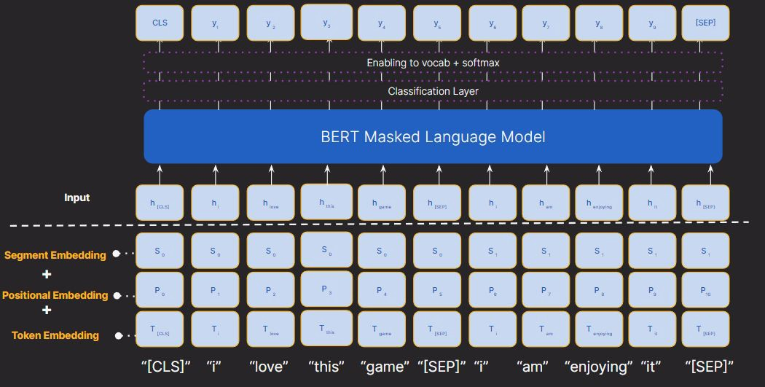
Working of BERT
Output

Slide 7
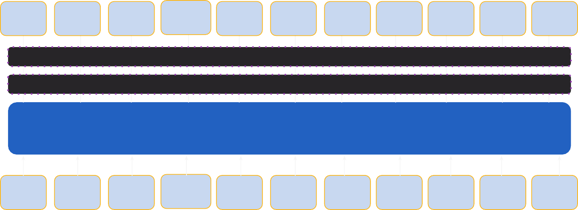
CLS
y₁
y ₂
y₃
y₄
y₅
y₆
y₇
y₈
y₉
[SEP]
Enabling to vocab + softmax
Classification Layer
BERT Masked Language Model
Input
h _{i}
^{h} this
h _{i}
^{h} [CLS]
^{h} love
^{h} game
^{h} [SEP]
^{h} am
^{h} enjoying
^{h} it
^{h} [SEP}
Segment Embedding
+
Positional Embedding
+
Token Embedding
S ₀
S ₀
S ₀
S ₀
S ₀
S ₀
S ₁
S ₁
S ₁
S ₁
S ₁
P ₀
P ₁
P ₂
P ₃
P ₄
P ₅
P₆
P ₇
P ₈
P₉
^{P}10
^{T} [CLS]
T _{i}
^{T} love
^{T} this
^{T} game
^{T} [SEP]
T _{i}
^{T} am
^{T} enjoying
^{T} it
^{T} [SEP}
“[CLS]”
“i” “love”
“this”
“game” “[SEP]” “i”
“am”
“enjoying” “it”
“[SEP]”

Slide 8
Working of BERT
Output

Slide 9
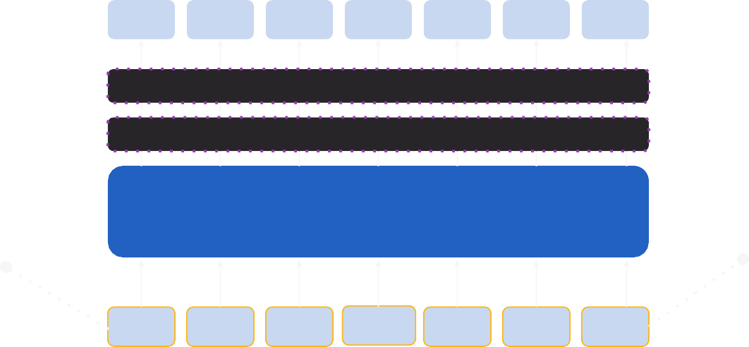
Working of BERT
Pre-training is done on a large amount of text to learn the contextual meaning.
Output
[CLS]
y1
y2
y3
….
yn
[SEP]
Enabling to vocab + softmax
Classification Layer
BERT Masked Language Model
Beginning
Separator
Input
[CLS]
x1
x2
x3
….
xn
[SEP]
“[CLS]”
“i” “love” “this”
“game” “[SEP]”

Slide 10
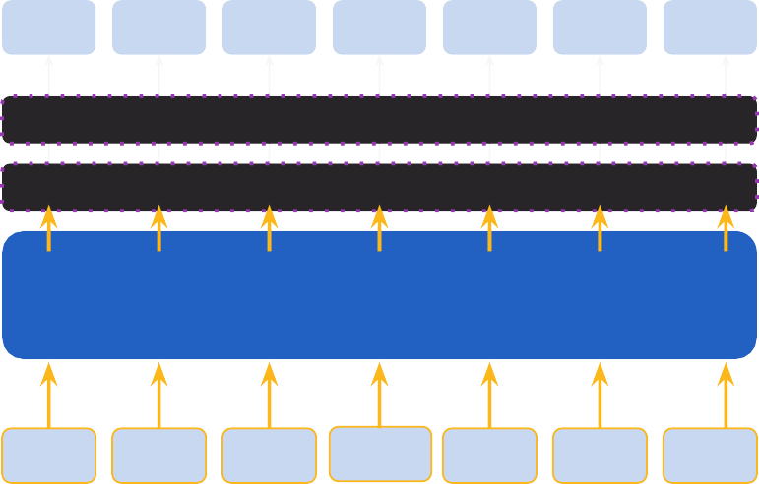
Encoder
Output
[CLS]
y1
y2
y3
….
yn
[SEP]
Add & Norm
Enabling to vocab + softmax
Feed Forward
Classification Layer
N_{X}
Add & Norm
BERT Masked Language Model
MMuullttii--Hheeaadd
seAlftatettnetinotnion
Input
[CLS]
x1
x2
x3
[SEP]
….
[SEP]
Encoder

Slide 11
Encoder 12
Encoder 1
Output
[CLS]
y1
y2
y3
….
yn
[SEP]
Add & Norm
Enabling to vocab + softmax
Feed Forward
Classification Layer
N_{X}
Add & Norm
BERT Masked Language Model
MMuullttii--Hheeaadd
seAlftatettnetinotnion
Input
[CLS]
x1
x2
x3
….
xn
[SEP]
Encoder

Slide 12
BERT
Encoder 12
Encoder 1
1
Pre - Training
Add & Norm
Feed Forward
2
Fine-Tuning
N_{X}
Add & Norm
MMuullttii--Hheeaadd
seAlftatettnetinotnion
Encoder

Slide 13
BERT
Encoder 12
Encoder 1
1
Pre - Training
Add & Norm
Feed Forward
Wikipedia of 2500 million words
Book corpus data of 800 million words
N_{X}
Add & Norm
MMuullttii--Hheeaadd
seAlftatettnetinotnion
Encoder

Slide 14
BERT
Encoder 12
Encoder 1
1
Pre - Training
Add & Norm
Feed Forward
Challenge of defining prediction goal
N_{X}
Add & Norm
Masked Language Model (MLM)
MMuullttii--Hheeaadd
seAlftatettnetinotnion
Next Sentence Prediction (NSP)
Encoder

Slide 15
BERT
Encoder 12
Encoder 1
1
Pre - Training
Add & Norm
Feed Forward
Challenge of defining prediction goal
N_{X}
Add & Norm
Masked Language Model (MLM)
MMuullttii--Hheeaadd
seAlftatettnetinotnion
Next Sentence Prediction (NSP)
Encoder

Slide 16
Masked Language Model (MLM)
“you” has the highest probability
you, they, your…….
Output
[CLS]
how
are
doing
today
[SEP]
BERT masks and replaces some words in input sequences with symbols like [MASK], to be predicted by the model.
Enabling to vocab + softmax
Classification Layer
BERT Masked Language Model
Input
[CLS]
how
are
[MASK]
doing
today
[SEP]

Slide 17
BERT
Encoder 12
Encoder 1
1
Pre - Training
Add & Norm
Feed Forward
Challenge of defining prediction goal
N_{X}
Add & Norm
Masked Language Model (MLM)
MMuullttii--Hheeaadd
seAlftatettnetinotnion
Next Sentence Prediction (NSP)
Encoder

Slide 18


Next Sentence Prediction (NSP)
Class Label
For a pair of sentences, BERT has to identify whether one sentence logically follows the next or not.
C
T₁
T_{N}
^{T}[SEP]
M₁
M_{m}
Enabling to vocab + softmax
Classification Layer
I love this game.
BERT
I am enjoying it.
^{E}cls
E₁
E_{N}
^{T}[SEP]
E`₁
E`_{m}
[CLS]
Tok 1
Tok N
[SEP]
Tok 1
Tok N
Platypus is a rare animal.
First Sentence
Second Sentence

Slide 19
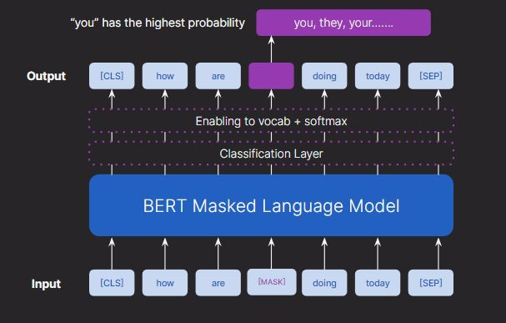
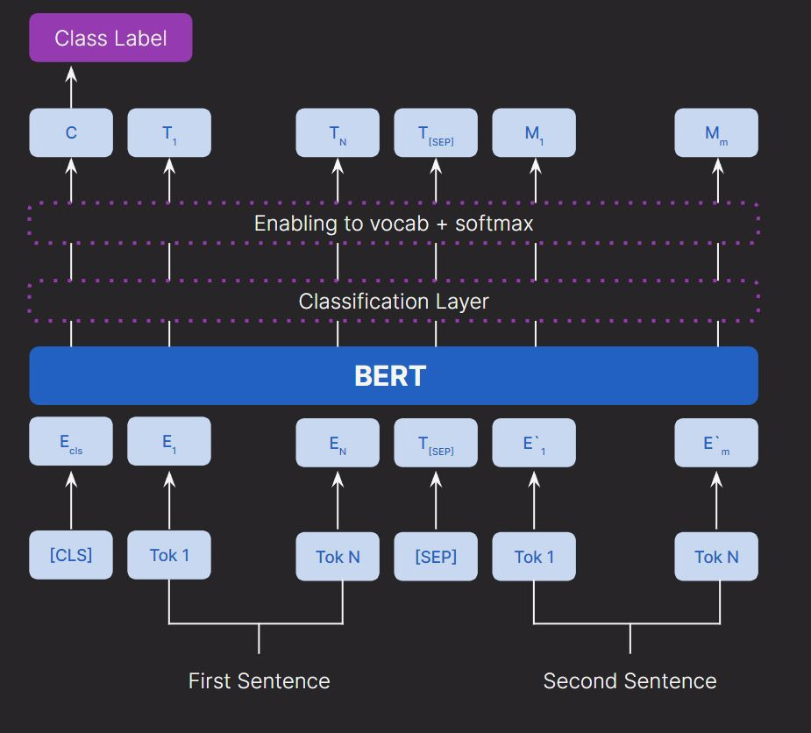
Analysis
Masked Language Model (MLM)
Next Sentence Prediction (NSP)
Understanding context within a sentence
Understand relationships between sentences

Slide 20

BERT
Encoder 12
Encoder 1
1
2
Pre - Training
Add & Norm
Feed Forward
Fine-Tuning
N_{X}
Add & Norm
Task specific dataset
MMuullttii--Hheeaadd
seAlftatettnetinotnion
Test Classification
Sentiment Analysis
Encoder
NER
POS tagging

Slide 21
2
Fine-Tuning
Output Layer Tuning
Full Model Fine Tuning Feature Extraction

Slide 22



Fine tuning
Output Layer Tuning
Full Model Fine Tuning
Feature Extraction
1. Domain Adaptive helps the model in Feature Extraction
Fine tuning all the layers of the model.
Task specific outer layer is trained while freezing the lower layers
Effective for large dataset.
2. Fine tuning on specific tasks

Slide 23

GLUE
General Language Understanding Evaluation
Measure performance of models on various language understanding challenges.

Slide 24
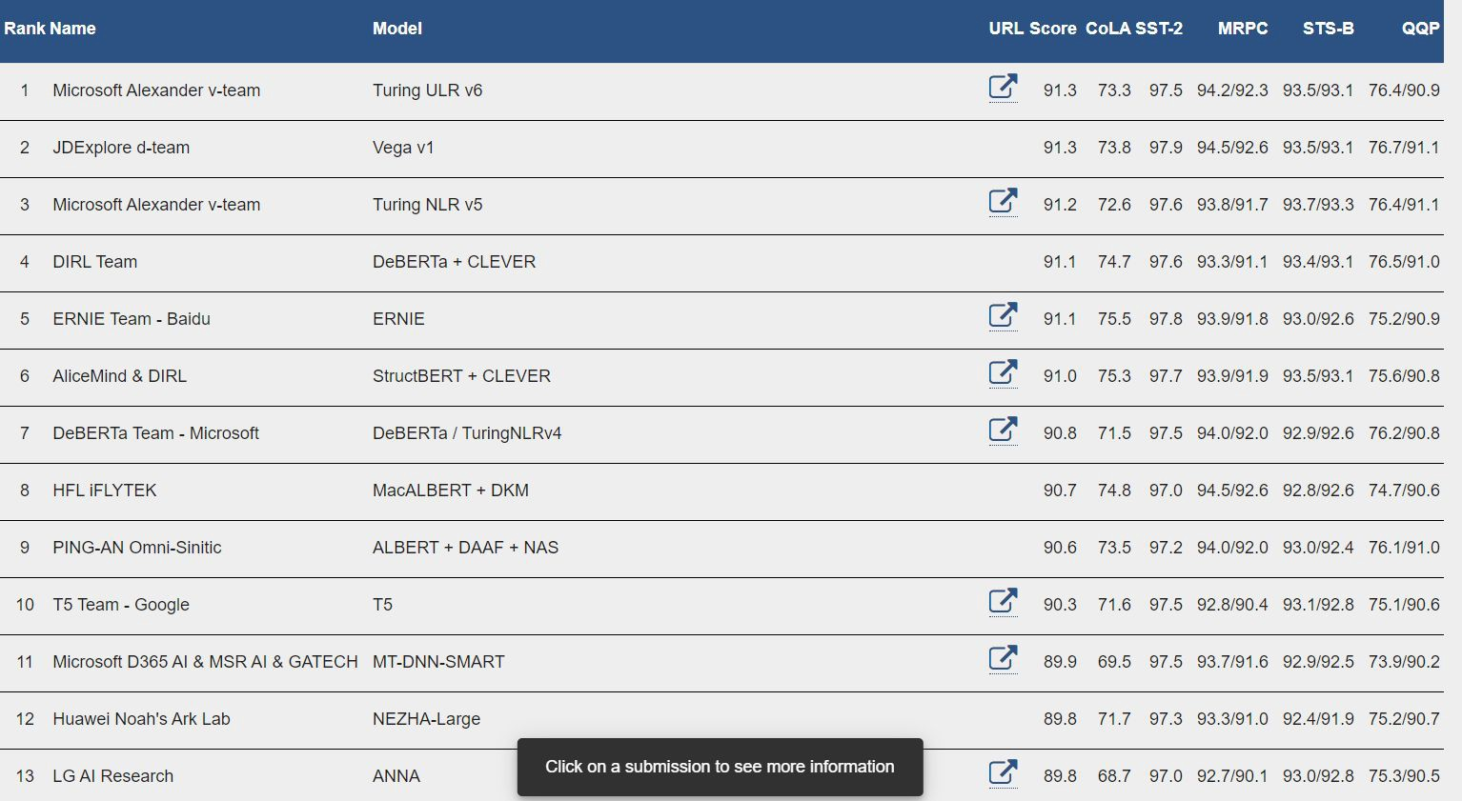

Slide 25
Preparing for LLMs
Video 3: Using Pre trained transformers : BERT

